Slide 1

Algorithm Complexity Analysis: Brute Force vs Greedy vs 2-opt Approaches
Comparing time complexity, accuracy, and practical applications of different algorithmic approaches to the Travelling Salesman Problem.
Made By Unknown Theons

Slide 2
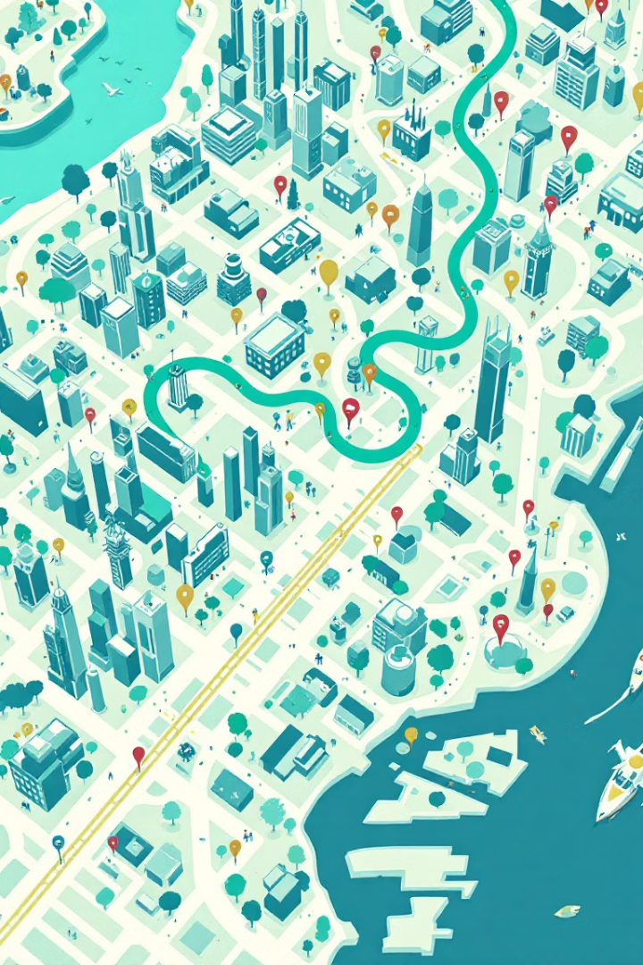




Brute Force Logic Explained
Preprocessing
Convert location dictionary into distance matrix using Euclidean distance.
Generate Permutations
Create all possible tours starting and ending at city 0.
Compute Costs
Calculate total distance for each possible path.
Find Optimal
Select the path with lowest total cost.

Slide 3
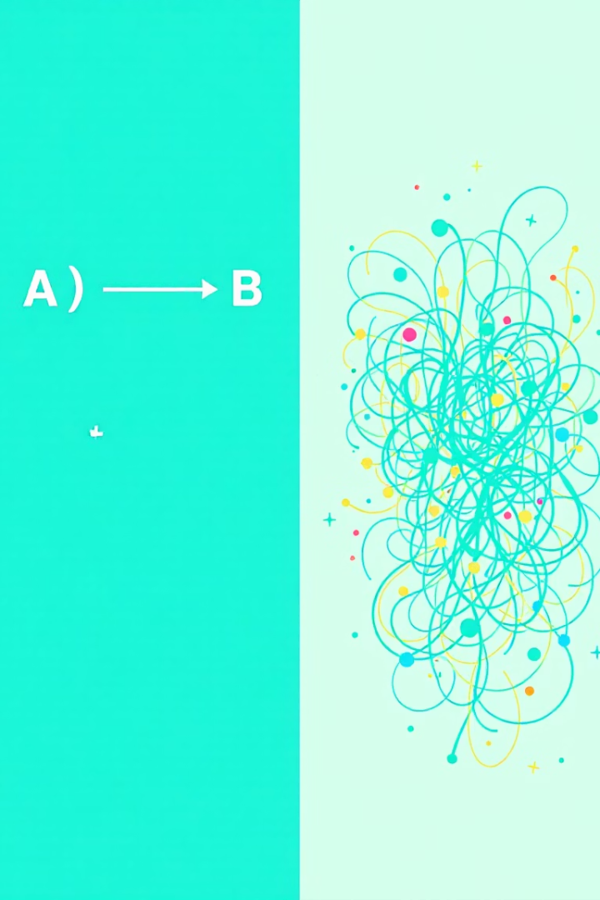
Algorithm Comparison
Criterion
Nearest Neighbor
Brute Force
Greedy
2-opt
Accuracy
Not guaranteed optimal
Guarantees optimal solution
Generally good, not always optimal
Improves initial solution; local search heuristic
Speed
Fast (O(n²))
Extremely slow O(n!)
Fast O(n²)
O(n²) per iteration, up to O(n⁴) in worst-case
Scalability
Works for large n
Impractical for n>10
Works well for large n
Effective for medium to large n
Implementation
Easy
High Computation power
Moderate complexity
Moderate complexity, iterative improvement

Slide 4

Example Demonstration
2-opt Result
Brute Force Result
Tour: 0→1→3→2→0 improved to 0→1→2→3→0. Total Distance: ~6.83 (optimal)
Greedy Result
Nearest Neighbor Result
Tour: 0→3→1→2→0. Total Distance: ~7.17 (better than nearest neighbor but not optimal)
Tour: 0→1→2→3→0. Total Distance: ~6.83 (optimal)
Tour: 0→1→3→2→0. Total Distance: ~7.41 (suboptimal)

Slide 5
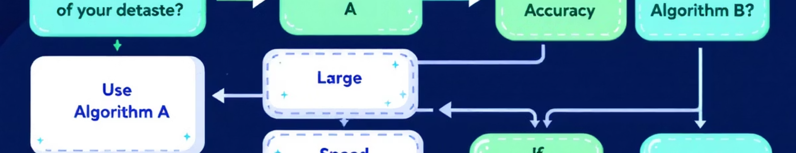
Algorithm Selection Guide
Nearest Neighbor
Brute Force
Recommendation
Fast implementation
Guarantees optimal solution
Use NN + optimization for practical cases
Scalable for large datasets
Simple to implement
Acceptable for real-time applications
Only for very small datasets (n≤10)
Use BF only when optimality is critical

Slide 6
Algorithm Reasoning and Comparison
Nearest Neighbor Logic
Greedy Algorithm Logic
2-opt Algorithm Logic
Comparison with Brute Force
Quickly selects the nearest unvisited city to build a tour.
Chooses locally optimal edges to form a tour iteratively.
Iteratively improves a tour by swapping two edges to reduce total distance.
Complexity: Nearest Neighbor & Greedy run in O(n²); 2-opt up to O(n⁴); Brute Force is O(n!).
Designed for fast, scalable solutions with decent accuracy.
Balances speed and solution quality by focusing on cheaper connections.
Starts from an initial solution and refines it through local search.
Performance: Brute Force guarantees optimal but impractical for large n.
Advantages: Very fast, handles large datasets well.
Advantages: Faster than brute force, better accuracy than Nearest Neighbor.
Advantages: Produces better quality tours, often reaching optimal or near-optimal.
Tradeoff: Heuristics provide faster results with slightly less accuracy.
Disadvantages: May produce suboptimal tours.
Disadvantages: Not guaranteed optimal.
Disadvantages: Slower than basic heuristics, with complexity up to O(n⁴) in worst cases.

